Slide 1



Introduction to AI
And its applications
Dileep Kumar Patchigolla
Lead AI Scientist
Target

Slide 2

About Speaker
Dileep Patchigolla has 12 years of experience in the field of Data Science across various industries such as retail, social media, gaming, mobile apps, and finance. He worked on various problems related to search, NLP, personalization, recommendation, user targeting, user segmentation etc using Machine Learning and Deep Learning based models.
He did his Bachelors from IIT Madras, and Masters from Georgia Tech. He is currently working as a Lead AI Scientist at Target.

Slide 3
Artificial Intelligence
“AI is the new electricity! Electricity transformed countless industries; AI will now do the same”
Andrew NG
Co-founder and head, Google Brain, Co-founder, Coursera

Slide 4
Agenda
What is AI?
How does AI work?
Machine Learning
Deep Learning
Advantages and challenges with Deep Learning
A few case studies
Common roles in industry & the skills required for them

Slide 5
What is AI?

Slide 6
AI – An overview
Machines that are programmed to think and act like humans
Origins in 1950s, when pioneers in different fields assembled to define AI
Interest from Computer Scientists, Mathematicians, Economists, Neuroscientists, Psychologists, Linguists
Early enthusiasm, followed by AI winter: 1950s to 1970s
Re-emergence of AI: 1980s
Modern AI: 2000s. Entry of Big data and compute power

Slide 7
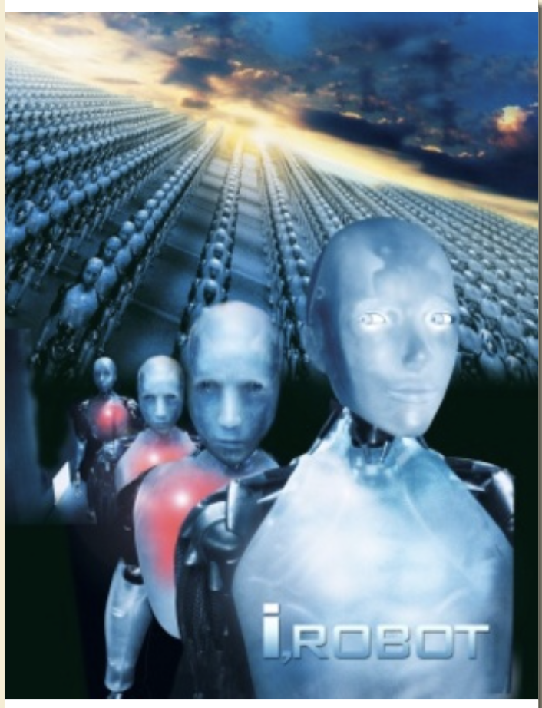
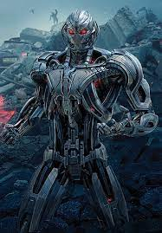
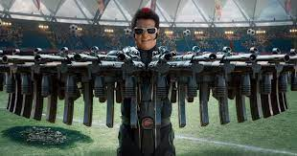
Hype-Artificial General Intelligence

Slide 8
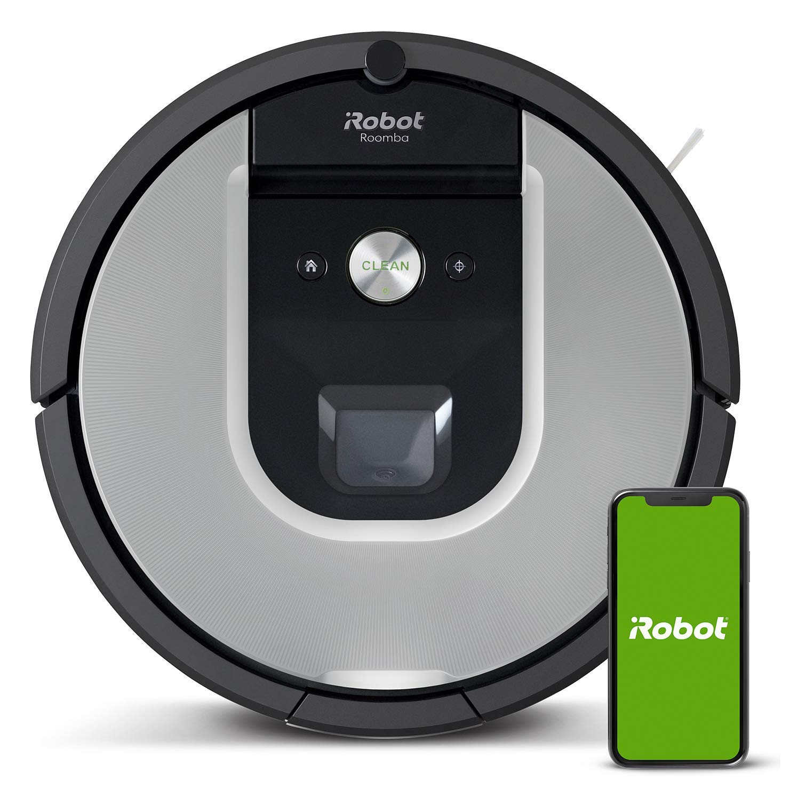
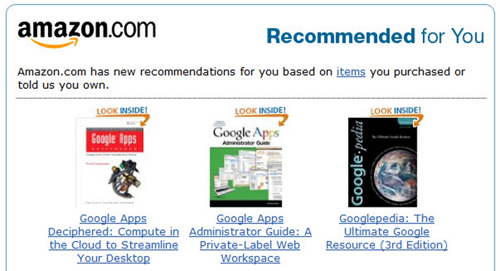
Reality – Artificial Narrow Intelligence

Slide 9
AI: Hype vs Reality
Artificial General Intelligence (AGI)
Artificial Narrow Intelligence (ANI)
Notes:
Image ref:
https://www.iceposter.com/thumbs/MOV_aaadbacc_b.jpg
https://m.media-amazon.com/images/I/71d-c9vu8cL._SL1481_.jpg

Slide 10
Applications of AI
Health-care: Medical imaging
E-commerce: Product recommendations
Search-engines: Natural Language, Information Retrieval
Logistics: Demand forecasting
Personal Assistants: Voice recognition, Audio to text,
Robots: Terrain mapping, self-balancing
Self-driving cars: Vision, decision making
Many, many more….

Slide 11
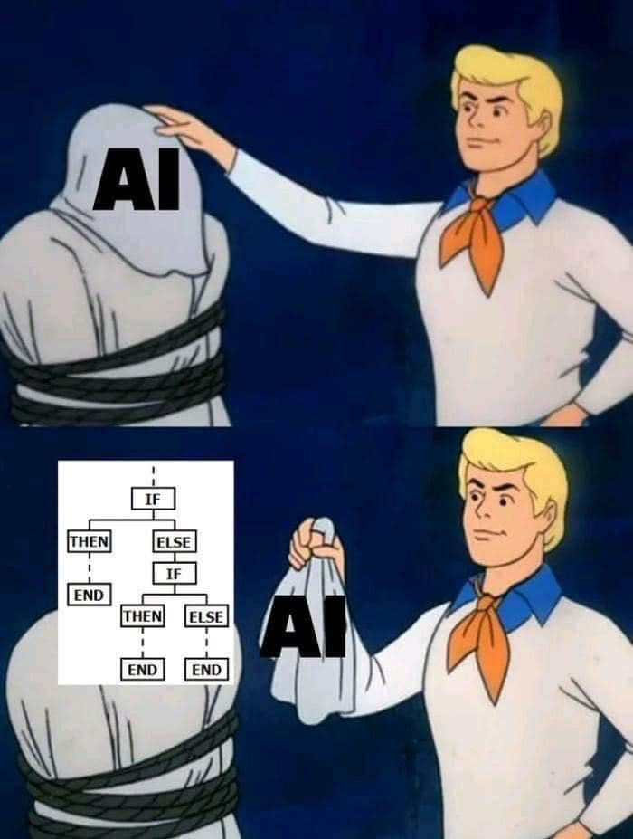
So, how does AI work?
Knowledge based approaches: Explicitly programmed.
Widely used in 80s and 90s
Requires a lot of domain expertise
Need to handle all specific cases
Not scalable
Time-consuming
What’s an alternative?
Using data – let computers program themselves
Notes:
Img: https://www.facebook.com/hadox.human.networks/photos/a.1649969678385513/3666876450028149/?type=3

Slide 12
Machine Learning & Deep Learning

Slide 13
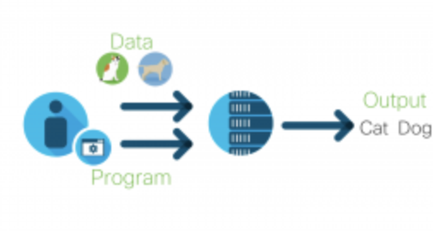
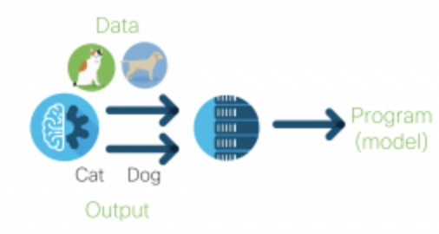
Software 2.0
Traditional programming
Programmer writes the rules
Cats have tail, pointy ears, have whiskers
Dogs have tail, floppy ears, etc
Machine Learning
Code generates the rules
Looks at lots of data
Extracts patterns

Slide 14
Types of Machine Learning
Supervised Learning
Used in making predictions
Requires data with labels
Ex: Spam detection, House price prediction, Medical diagnosis
Unsupervised Learning
Used in pattern detection
Requires data, but doesn’t require labels
Ex: Customer segmentation, anomaly detection
Reinforcement Learning
Used in decision making
When there is a lag between a decision and outcome
Ex: Chess, Robot motion control

Slide 15
An Example – Spam Detection
In the city for the weekend. Let’s catchup!
CONGRATS!!! YOU’VE WON $100 MILLION. CLICK HERE TO CLAIM
Features:
From address
Words
Grammar
Punctuations/capitals etc
Domain name (gmail.com, Hotmail.com etc)
Label: spam vs not-spam

Slide 16
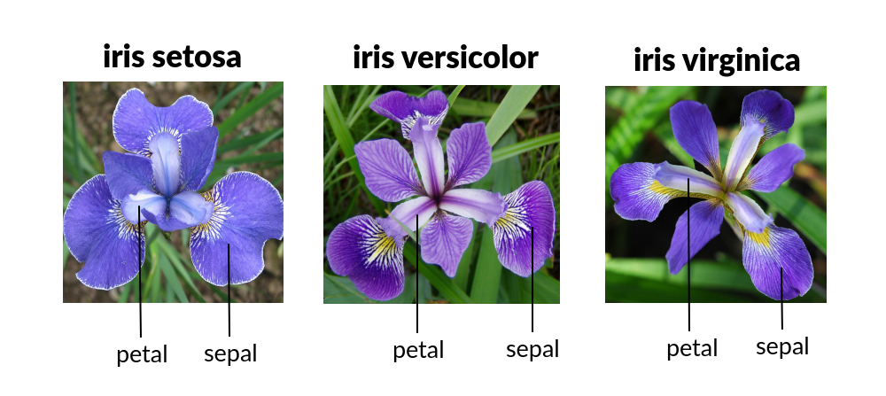
ML – An Example
Notes:
Image:
https://i.imgur.com/PQqYGaW.png
https://www.javatpoint.com/classification-algorithm-in-machine-learning

Slide 17
Another example – Facial recognition
Notes:
Image Ref:
https://www.cnet.com/news/now-you-can-tell-facebook-not-to-recognize-your-face/
http://introtodeeplearning.com/slides/6S191_MIT_DeepLearning_L1.pdf

Slide 18
Problems?
Need to do lots of feature-engineering
Domain knowledge required
May not be scalable with lots of edge cases
So, what if the model can learn features too?

Slide 19
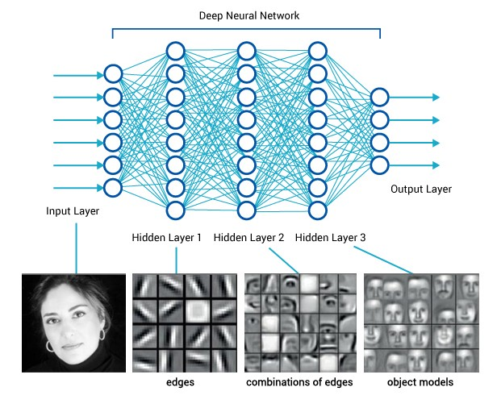
Deep Learning
Built on a fundamental unit called perceptron
Inspired from the neural connections in our brain
A single unit (perceptron, aka neuron) is a weak learner, but with millions of connections, the whole network gains a lot of predictive power
These networks are called neural networks
Notes:
Ref:
https://medium.com/diaryofawannapreneur/deep-learning-for-computer-vision-for-the-average-person-861661d8aa61

Slide 20
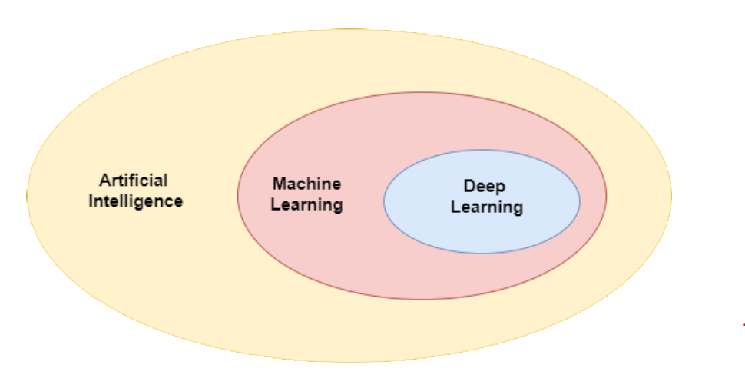
AI vs ML vs DL
AI: Any system that simulates intelligence
ML: An approach to build systems that can automatically learn patterns from data, without explicitly programming
DL: A subset of ML, which uses a specific family of algorithms involving Neural Networks
Notes:
Image ref: https://www.quantib.com/hs-fs/hubfs/assets/pillar%20pages/The%20ultimate%20guide%20to%20AI%20in%20radiology/images/Pillar%20page%20-%20figure%201-7-min.png?width=1908&name=Pillar%20page%20-%20figure%201-7-min.png

Slide 21
Era of Deep Learning
Neural Networks were first proposed in 1940s. Lots of research in 80s.
Promising, but was never so popular till early 2000s
So, why did Deep Learning become popular only in recent years?
Big Data – DL models are data hungry. Internet, mobile-phones, and big data infra created enormous datasets
Hardware – DL models are compute intensive. GPUs accelerated model training
Software – Frameworks such as Tensorflow & PyTorch enabled fast iterations

Slide 22
Challenges with Deep Learning
Domain specific labeled data may still be scarce. DL models can’t work with small data
Model complexity – more training & debug time
Black boxes – tough to debug. Lack of transparency
Deployment – large models, latency and hardware challenges
So, traditional ML models are still being used in a wide variety of problems

Slide 23
Deep Learning Breakthroughs - 1
AlphaGo
Go - A 3000 year old game
Widely accepted as the most challenging strategy game
AlphaGo, an AI that learnt Go only by viewing and playing games. No rules were programmed
Beat world champion 4-1, and overturned hundreds of years of game’s wisdom by its creative game play

Slide 24
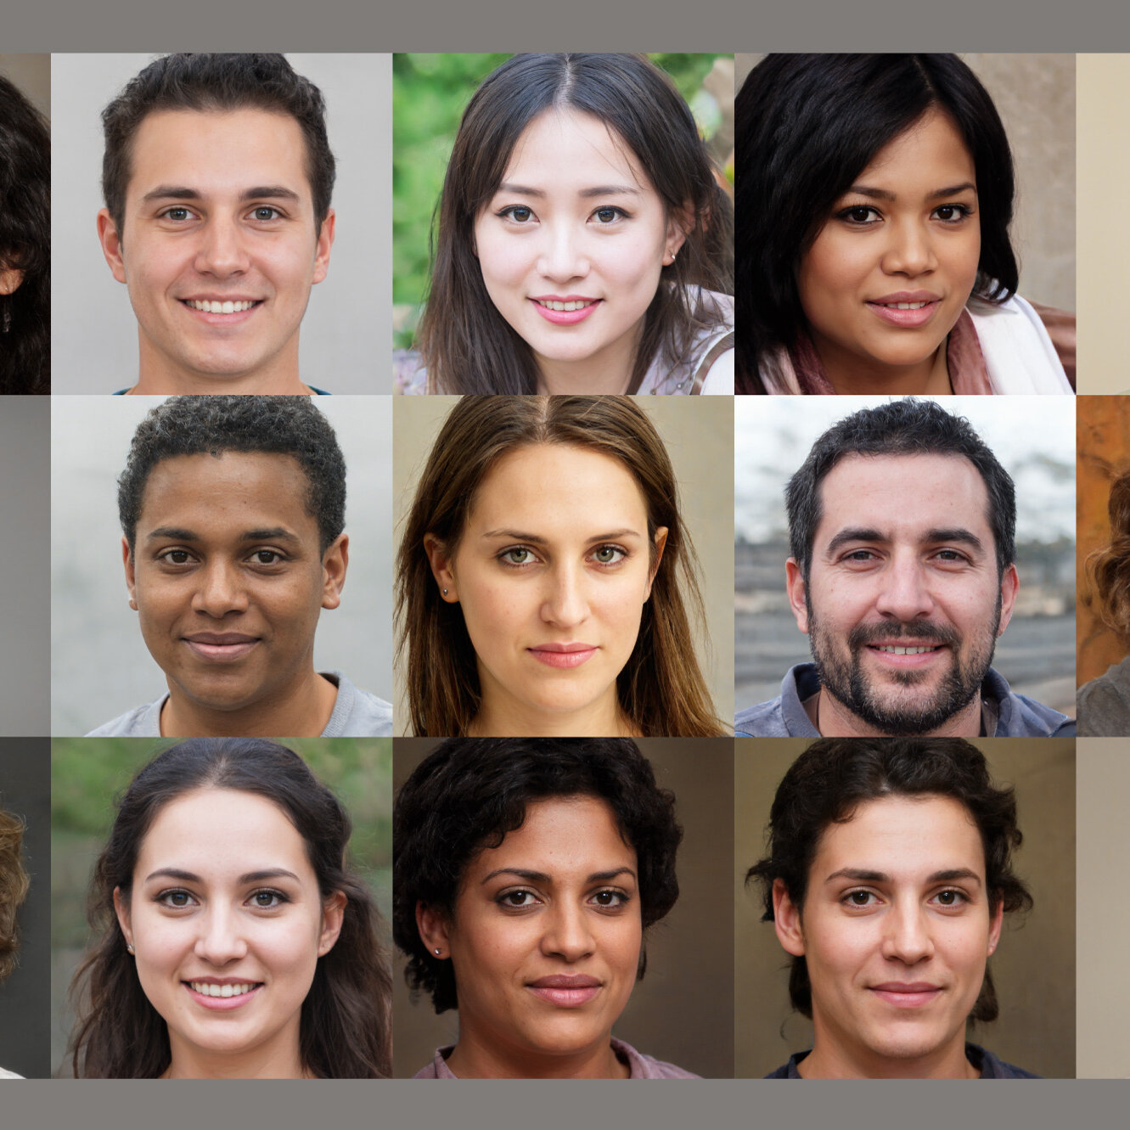
Deep Learning Breakthroughs - 2
All these faces are generated by an AI

Slide 25
Deep Learning Breakthroughs- 3
GPT 3
Text classification, Question Answering, Text generation, summarization, language translation etc
Converts instructions to code
Generates images from text
175 Billion parameters – 350 GB memory
Trained on 45 TB of text data
Costed $12 million to train
Notes:
Notes:
https://i.ytimg.com/vi/j4xgkjWlfL4/maxresdefault.jpg

Slide 26
Applications in daily life
Traditional Machine Learning
Deep Learning
Product recommendations
Logistics planning
Fraud detection
Churn prediction
Marketing analytics
Supply-demand forecasting
Chatbots
Virtual Assistants
Search-engines
News summarization
Healthcare
Self-drive cars

Slide 27
Skills required
Math
To understand how models work, to pick the right models, debug when they don’t work
Computer Science
To handle the huge datasets, setup training jobs, and deploy trained models in production
Product Knowledge
To convert business problem to a data problem, create features, identify opportunities using data

Slide 28
Career paths

Slide 29
Typical careers
Research scientist
Develops new algorithms & publishes papers at conferences
Typically works in universities or R&D centers of MNCs
Often holds a PhD
Skills required: ML Algorithms, Linear Algebra, Statistics, Calculus, C++, Python
Data scientist
Uses existing algorithms and trains them on business problems
Gathers and cleans data, creates insights from data
Often holds a Masters degree, sometimes, a Bachelors
Skills required: Statistics, Linear Algebra, ML Algorithms, Python, Spark, SQL, Domain knowledge, hacker mindset

Slide 30
Typical careers (Cont )
Machine Learning Engineer
Works closely with a Data Scientist. Takes trained models and productionizes them
Maintains the models in production, responsible for real-time functioning of models
Skills required: Software tools, cloud applications, ML Algorithms, Python, Java
Big Data Engineer
Builds the platforms required for the data to be collected, stored, and used for by the data scientists
Is not involved with ML models directly, but acts as a back-bone of ML platforms
Skills required: Software tools, Big data (Hadoop, Spark) & cloud applications, Java
Data Analyst
Uses data driven insights to improve product
Skills required: SQL, communication skills, product insight, statistics

Slide 31
Practical tips
Courses
Hackathons
Data Structures & Algorithms
Internships
Personal projects
Blogs & Newsletters – read and write
Social Media – create presence in LinkedIn and Twitter, follow industry leaders

Slide 32


Manipal University Jaipur, Dehmi Kalan, Off Jaipur-Ajmer Expressway, Jaipur, Rajasthan 303007
+91 7304 000 444
info@onlinemanipal.com
www.onlinemanipal.com

